Slide 1
WEEK 10 · LECTURE 19
Where This Leaves You
Course review, and the state of the field as of August 2026
Ninety minutes. No notebook tonight. The last half hour is an open
argument about your own working life, and you do the arguing.
Final presentations are Thursday. Nothing here adds to that.
ISBA 2411 · Natural Language Processing & AI · Summer 2026

Slide 2
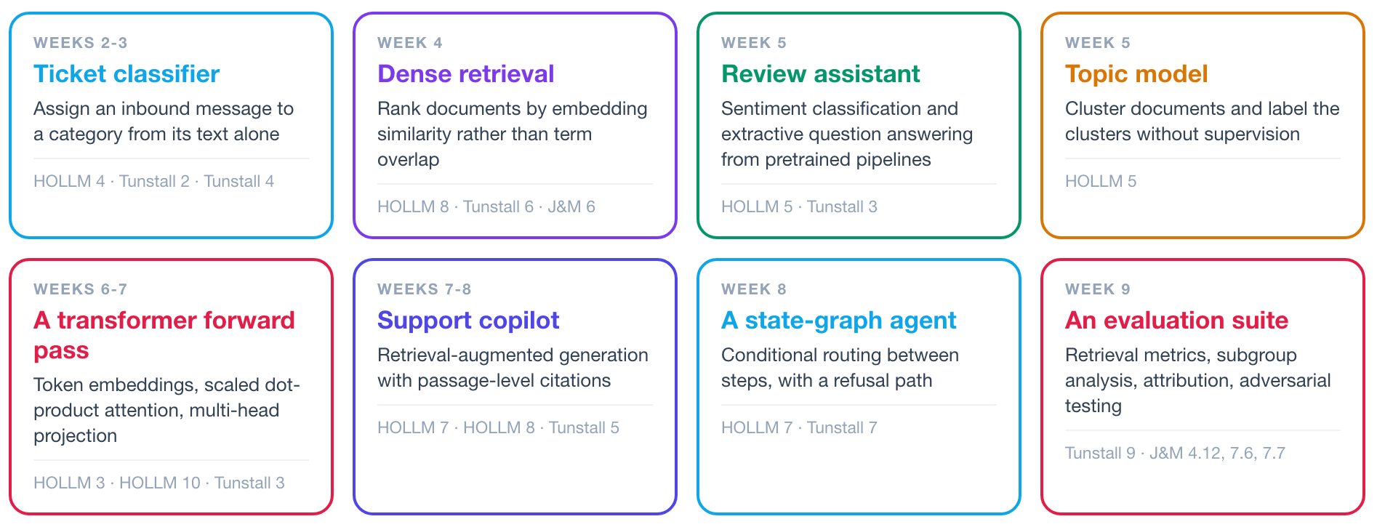
1 What we learned
2 What changed
3 By 2028
WHAT WE LEARNED
Eight systems built this term, and the chapters behind each
Each box is a system this class implemented. The reading it draws on is listed beneath it.
ISBA 2411 · Natural Language Processing & AI · Summer 2026

Slide 3
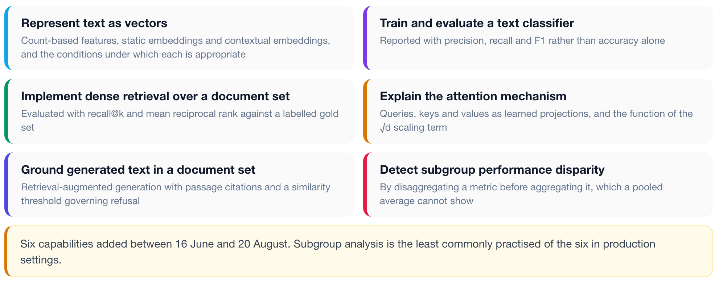
1 What we learned
2 What changed
3 By 2028
WHAT WE LEARNED
Six capabilities added between 16 June and 20 August
Stated as tasks you can now perform and describe, which is the form an employer asks in.
ISBA 2411 · Natural Language Processing & AI · Summer 2026

Slide 4
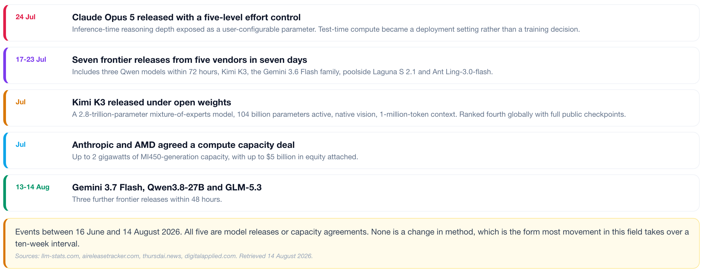
1 What we learned
2 What changed
3 By 2028
WHAT CHANGED
Five developments in the field during these ten weeks
Dated events between 16 June and 14 August 2026, over the period the syllabus was fixed.
ISBA 2411 · Natural Language Processing & AI · Summer 2026

Slide 5
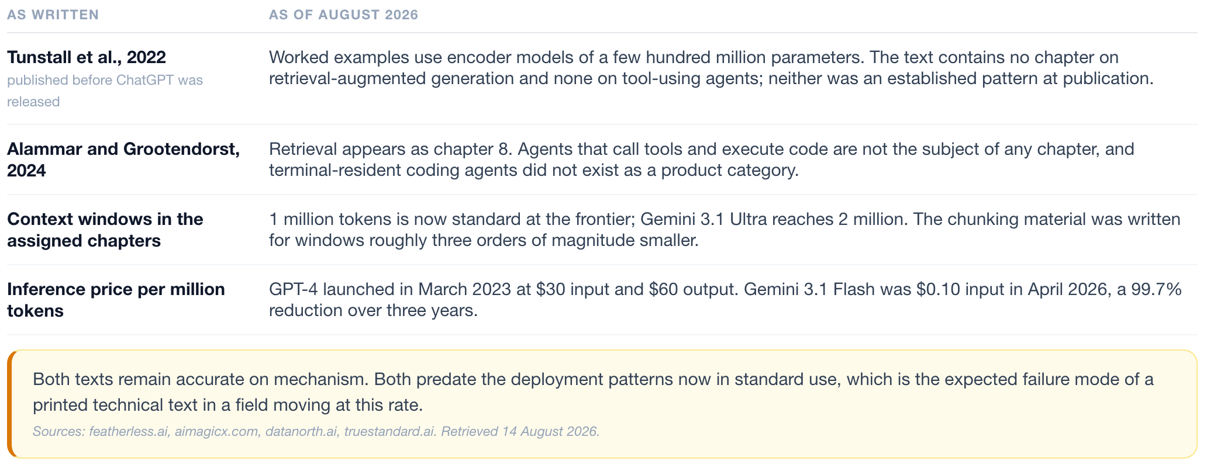
1 What we learned
2 What changed
3 By 2028
WHAT CHANGED
The assigned texts against current practice
Both remain correct on mechanism. Both were completed before the current deployment patterns.
ISBA 2411 · Natural Language Processing & AI · Summer 2026

Slide 6
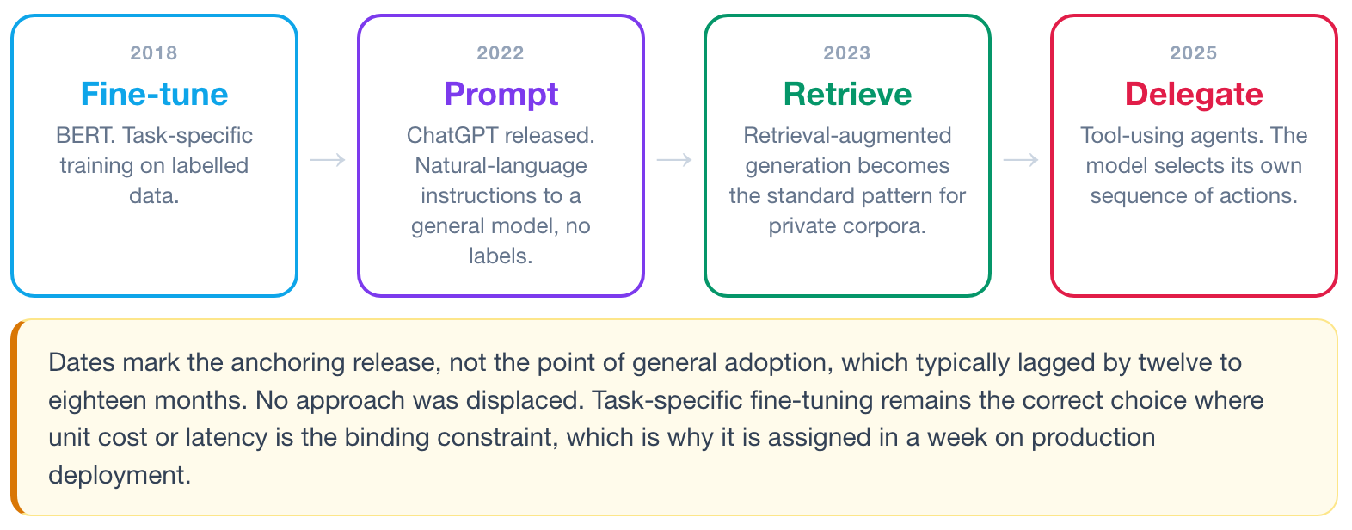
1 What we learned
2 What changed
3 By 2028
WHAT CHANGED
The default first approach has changed four times since 2018
The question is constant: given a new task and no existing system, what is attempted first.
ISBA 2411 · Natural Language Processing & AI · Summer 2026

Slide 7
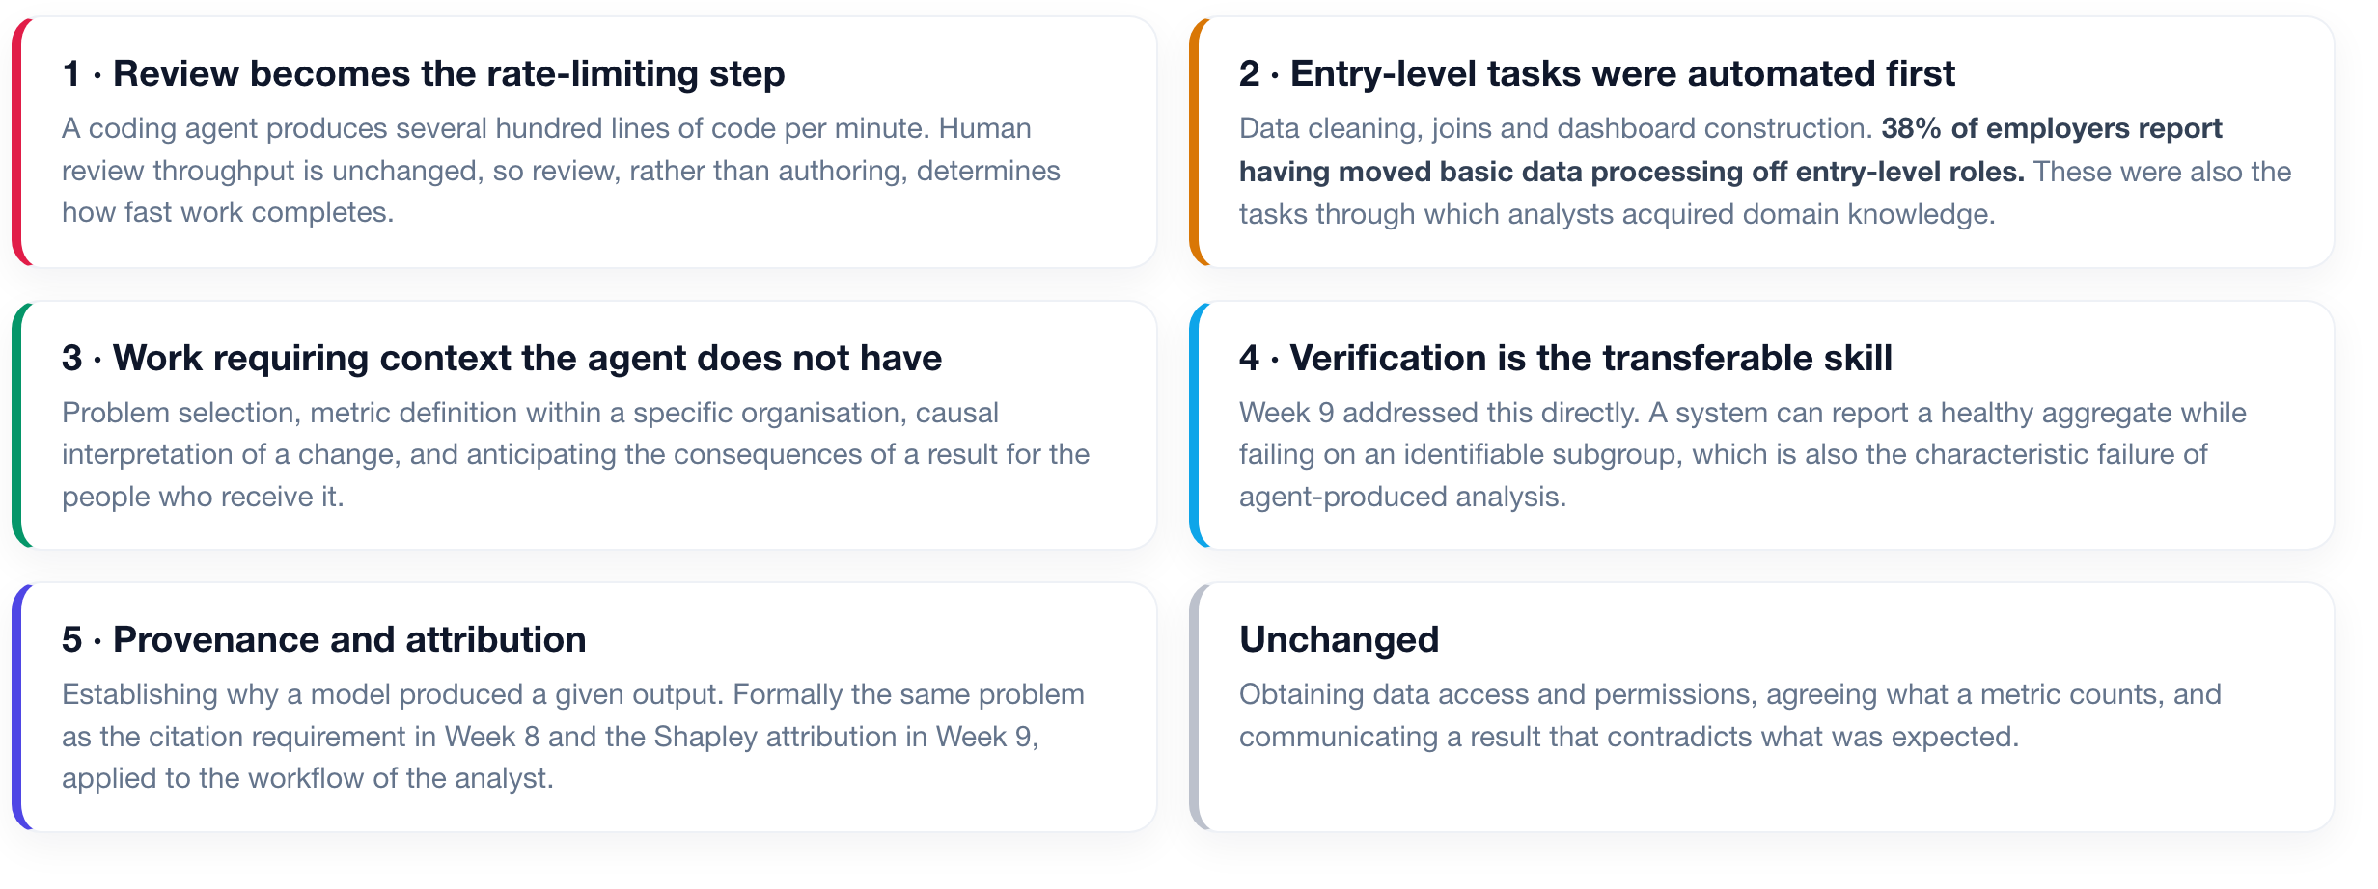
1 What we learned
2 What changed
3 By 2028
WHAT CHANGED
Five effects of coding agents on analytics work
No assigned chapter covers this. The category did not exist when either text was written.
ISBA 2411 · Natural Language Processing & AI · Summer 2026

Slide 8
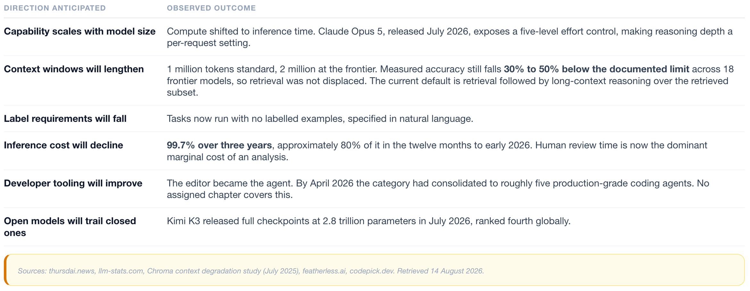
1 What we learned
2 What changed
3 By 2028
WHAT CHANGED
Six anticipated directions, and the observed outcome of each
Direction was predicted accurately in every row. The form it took was not.
ISBA 2411 · Natural Language Processing & AI · Summer 2026

Slide 9
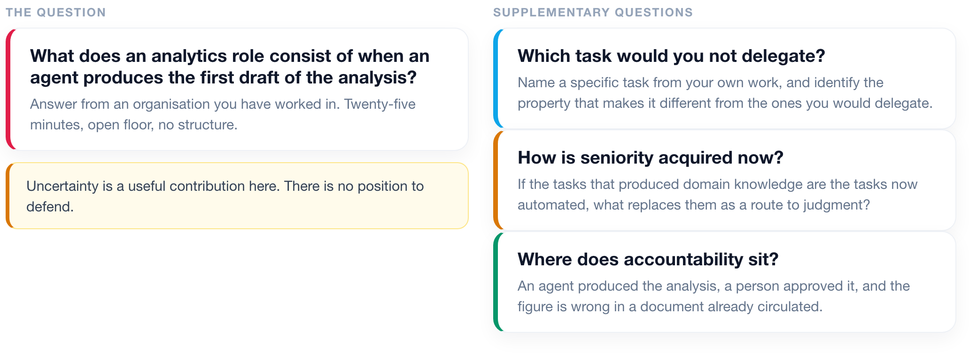
1 What we learned
2 What changed
3 By 2028
BY 2028
Discussion: the analytics role under agent-assisted work
Twenty-five minutes, unstructured. Answer from an organisation you have worked in.
ISBA 2411 · Natural Language Processing & AI · Summer 2026

Slide 10
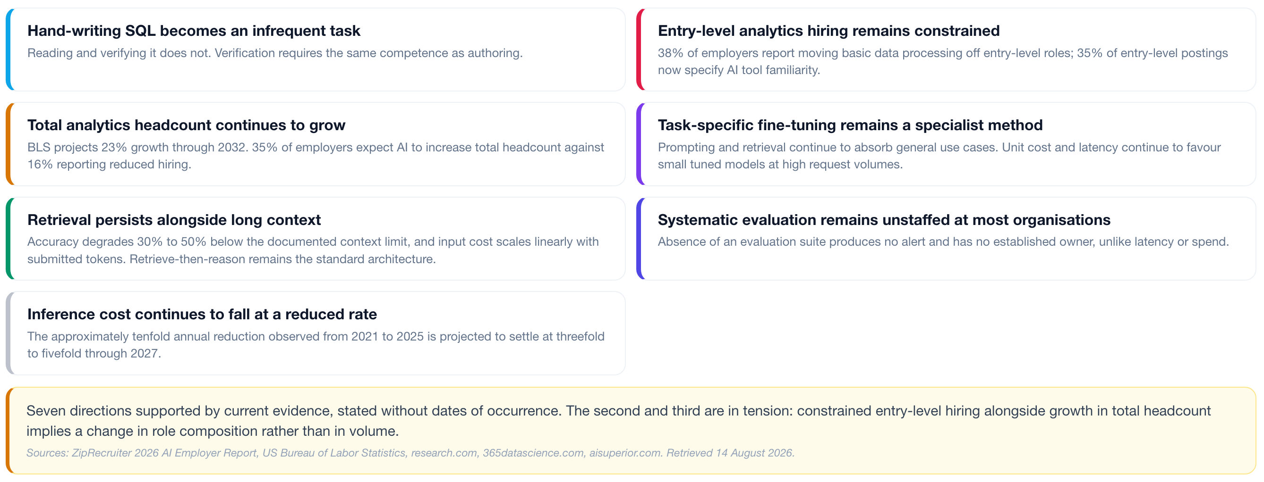
1 What we learned
2 What changed
3 By 2028
BY 2028
Likely future outcomes by 2028
Seven directions supported by current evidence. Each is open to challenge.
ISBA 2411 · Natural Language Processing & AI · Summer 2026

